Slide 1
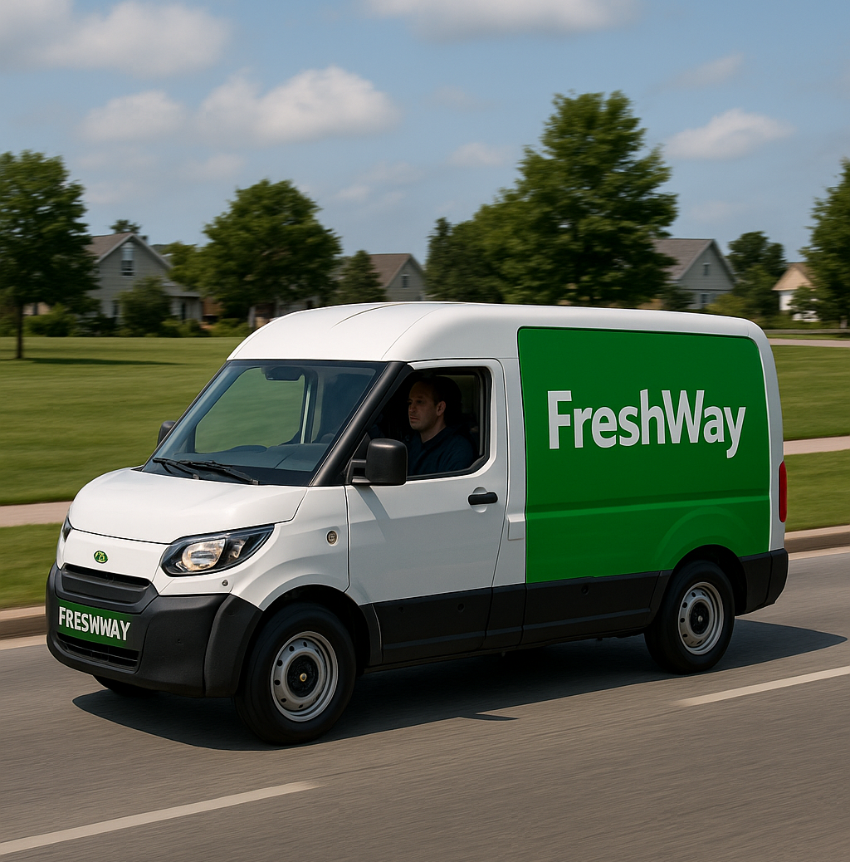
Smart logistics
Lesson 5 – AI in logistics
Minor SCE

Slide 2

One IT incident, empty shelves
In the news · this week
Sunday 11 October: a cybersecurity incident. Ahold Delhaize takes its systems offline.
Several Albert Heijn distribution centres stop. Fresh produce runs out in the stores.
Stores and checkouts keep working.
Your chain: if one IT system goes down, what stops first?
Source: NOS and Reuters, October 2026
Notes:
Nieuws van deze week · storing Ahold Delhaize · nieuw 16-10-2026
Doel: openen met iets wat studenten zelf in de winkel hebben gezien. De les gaat over wat (gen)AI in de logistiek kan; deze dia laat eerst zien hoe afhankelijk de goederenstroom al is van digitale systemen. Kort houden (3 tot 5 min): vraag stellen, twee of drie antwoorden ophalen, door naar Today.
Wat bevestigd is (stand vrijdag 16-10-2026):
- Begonnen op zondagmiddag 11 oktober. Ahold Delhaize spreekt van een "cybersecurity incident" en een "security issue" op het netwerk en heeft uit voorzorg systemen offline gehaald.
- Geraakt: in Nederland Albert Heijn, Etos en Gall & Gall; in België Delhaize en Albert Heijn België; in de VS websites en online bestellingen van Food Lion, Hannaford, Stop & Shop en de Giant-ketens.
- Bij Albert Heijn lag het werk in meerdere distributiecentra stil, omdat de systemen uit voorzorg waren uitgezet (topvrouw Margaret Versteden-van Duijn tegen de NOS). Volgens een mail aan leveranciers (RTL Z) draaide alleen Zaandam nog, met vaste tijdslots voor leveranciers.
- Vers, vooral groente en fruit, raakte op; houdbaar, brood en diepvries bleven er. Op 14 oktober verwachtte AH alle DC's weer draaiend, droog eerst, vers later. Delhaize kon de eerste dagen niet bestellen voor de winkels en leverde op basis van eerdere bestellingen. De kassa's bleven werken.
- Op 16 oktober worden winkels weer gewoon bevoorraad; online bestellen en thuisbezorgen bij AH liggen stil tot zeker zondag 18 oktober.
- Ahold: geen aanwijzing dat klant- of medewerkersgegevens zijn gestolen, onderzoek loopt, systemen worden "gecontroleerd herstart". Geen oorzaak of dader genoemd.
Niet bevestigd, dus niet als feit brengen:
- Of het een hack is. NOS en RTL schrijven op basis van experts dat het om een aanval gaat, een hoogleraar denkt aan een DDoS-aanval; Ahold bevestigt geen van beide en er heeft zich geen dader gemeld.
- De schade: experts schatten circa 10 tot 21 miljoen euro, geen cijfer van Ahold.
- Het NCSC ziet geen verband met de gelijktijdige aanval op koelsystemen van winkels in Frankrijk.
Mogelijke doorvragen: waar zat de kwetsbaarheid (niet in de winkel, maar in de planning en het DC)? Waarom raakte vers het eerst op? Wat is het noodplan als je bestelsysteem uit staat (Delhaize leverde op basis van eerdere bestellingen)? Brug naar de les: hoe meer AI in de planning, hoe belangrijker die vraag.
Bronnen:
- NOS, 15-10-2026: https://nos.nl/artikel/2635123-problemen-hackaanval-albert-heijn-houden-aan-rest-van-de-week-geen-bezorging
- Reuters (via The Star), 13-10-2026: https://www.thestar.com.my/tech/tech-news/2026/10/13/ahold-has-no-indication-client-data-was-stolen-in-cybersecurity-incident
- VRT NWS, 13-10-2026: https://www.vrt.be/vrtnws/nl/2026/10/13/de-it-problemen-bij-delhaize-en-albert-heijn-blijven/
- NL Times, 12-10-2026: https://nltimes.nl/2026/10/12/empty-shelves-likely-albert-heijn-cyber-incident-extends-parents-us-business
- NL Times (met ANP), 14-10-2026: https://nltimes.nl/2026/10/14/albert-heijn-recovery-underway-cyberattack-damage-likely-tops-eu10-million
Geen persbericht van Ahold Delhaize zelf gevonden; citaten via deze media. Het citaat van de topvrouw is alleen bekend via media die de NOS aanhalen. De stand verandert nog: check vlak voor de les of bezorgen weer werkt.
Logo Albert Heijn: Wikimedia Commons, File:Albert_Heijn_Logo.svg, https://commons.wikimedia.org/wiki/File:Albert_Heijn_Logo.svg (public domain als tekstlogo, PD-textlogo; wel een handelsmerk van Albert Heijn). Hier alleen gebruikt om het nieuwsitem aan te wijzen. Bestand: assets/logo-ah/ in de map Smart Logistics.
GenAI: feiten verzameld door Onno (Claude) in vijf bronnen, dia en notitie gemaakt met Claude. Human-AI Agency Label: AI Truster, totdat Frits de bronnen naloopt (dan Critical Verifier).

Slide 3
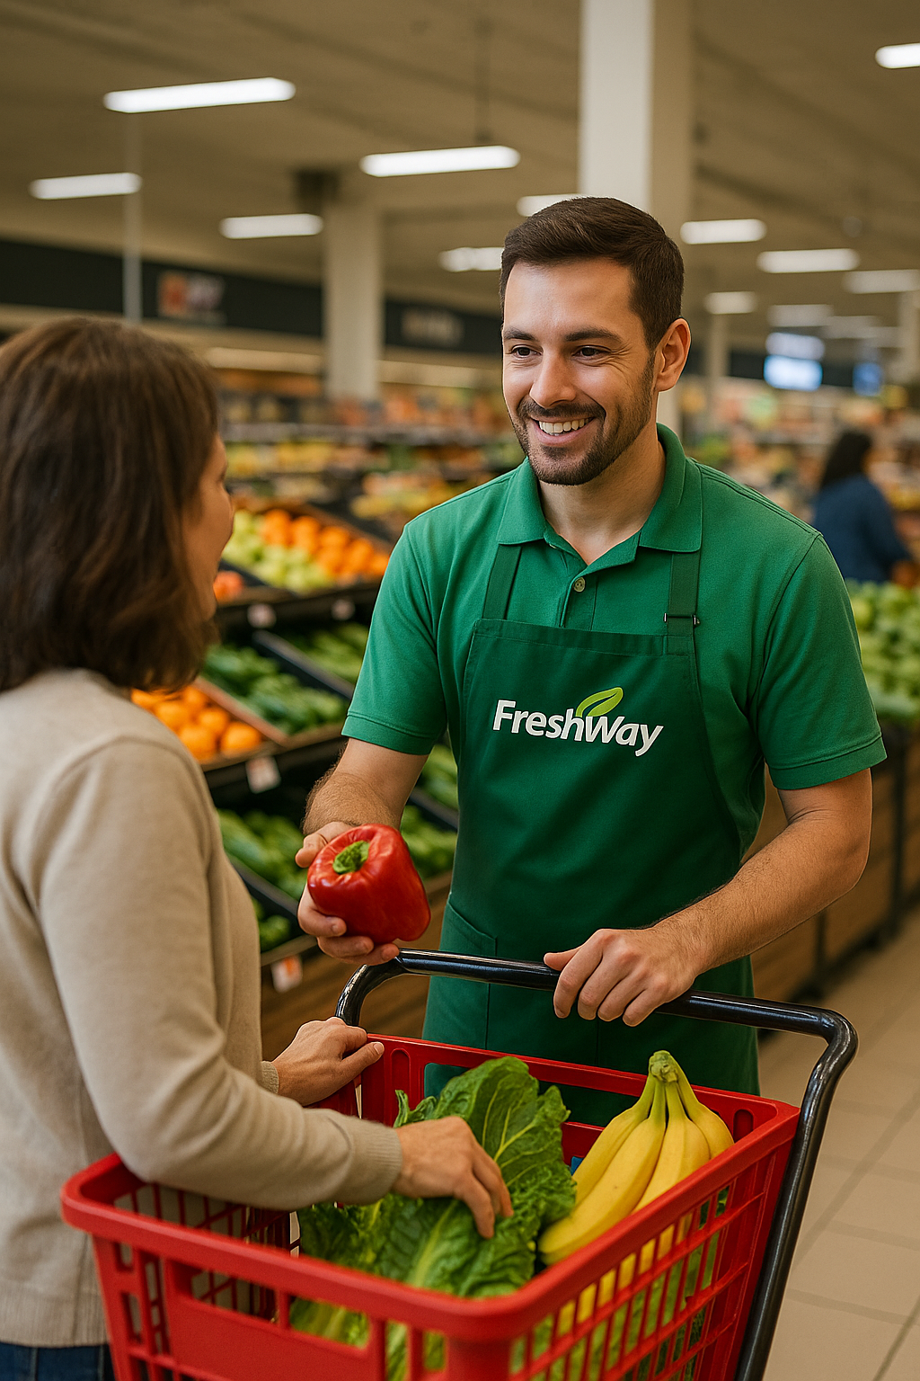
Course Overview
Smart logistics
1 Introduction and company start-up
2 Smart logistics and business intelligence
3 Data driven logistics
4 Digital developments
5 AI and GenAI in logistics
6 Self organising logistics
7 Sensors and smart supply chains
8 Consolidation and alignment
9 To be announced
Notes:
Standardised nine-topic list, canonical English wording from the lesson-concept document (Sept 2026).
If the nine-lesson concept is not adopted, delete this slide and keep the old one.

Slide 4
Today
Lesson 5
08:45
20′
Board opening: commitments, Board Memos and SA3
09:05
50′
Masterclass: AI in logistics
09:55
10′
Break
10:05
35′
The five bodies: whose data does your AI need?
10:40
30′
Department work: your AI Impact Note
11:10
5′
Board close: your commitment for lesson 6
Notes:
08:45 · agenda, 30 seconden
Loop de agenda kort door. Zelfde standaardritme van 150 minuten als in les 3 en 4: Board opening met doorloop van de toezeggingen 20, masterclass 50, pauze 10, de vijf organen gelijktijdig 35, afdelingswerk 30, Board close 5. Oranje is het blok aan de eigen tafel.
De masterclass (50 min): ontwikkelingen in (gen)AI en de impact op logistiek (dia Program of today). Ongeveer 15 min Flip the classroom, 15 min casussen (de zes bewijsdia's, Amazon en de casussen 2026; Five questions en AI Act kort) en 20 min vibecode-opdracht. De vibecode-opdracht vervangt sinds 16-10 de transportplanning-oefening (besluit Frits).

Slide 5
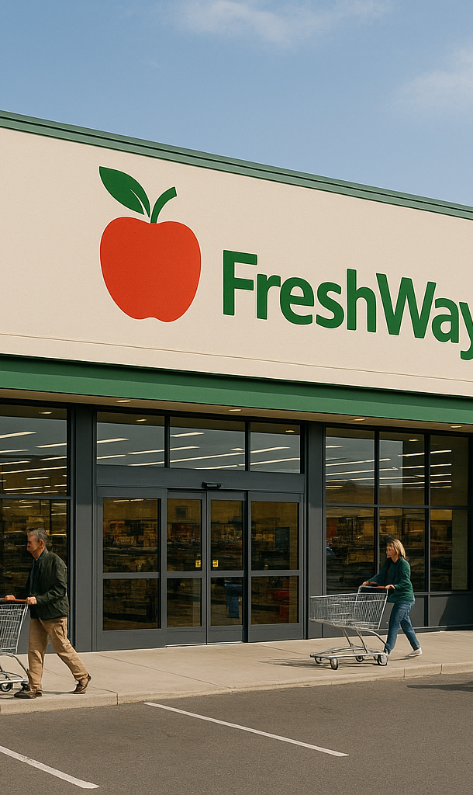
Smart warehousing & transport
Smart Logistics
New technologies and innovations:
New technologies offer the opportunity to make our logistics smarter
That not only leads to lower costs, but also to faster and more flexible processes
Smart logistics is about the smart organization of our logistics processes

Slide 6
Board opening and commitments
Lesson 5 · Board opening
Frits Coers
CEO Operations & Technology
1 The Board walks through the Decision Log. You may correct us.
2 Each manager on the lesson 4 commitment: met · not met and why · adjusted in advance
Wilbur Hage
CEO Finance & Logistics
3 Your Board Memos, feedback on SA3, the mandate files. One department presents.
Adjusting in advance costs nothing. Staying silent is the only real failure.
Notes:
08:45 · 20 min · beide docenten
Volgorde: (1) de Board loopt de Board Decision Log door; studenten mogen ons corrigeren. (2) Elke Department Manager beantwoordt de toezegging uit les 4: gehaald, niet gehaald en waarom, of vooraf bijgesteld. Vraag daarbij of de afdeling die geciteerd werd in het Technology Register dat heeft bevestigd (lespagina: 'confirm the Technology Register entry you were cited in'). Het antwoord gaat in de MT-notulen. (3) De Board Memo's uit les 4 en de algemene feedback op SA3. Daarna presenteert één afdeling haar digitale ontwikkelingen: dia's Presentation time en Feedback.
Mandaatfiles: Incoming transport (Compliance File), Storage (Energy & Capacity File) en E-commerce (Customer Promise) hebben vóór deze les versie 1 ingeleverd. Vraag de drie managers of ze er zijn. Vanaf nu zijn ze de randvoorwaarde voor de andere vier afdelingen in SA4. Ontbreekt er een, dan kan een geraakte afdeling een Non-Delivery Notice indienen; die wijst naar de gedateerde regel in de MT-notulen van les 4.
De vier regels die het formatief houden: vooraf bijstellen kost niets en wordt genoteerd, niet aangerekend; zwijgen is het enige echte verzuim; een gemiste toezegging die een ander raakt, kan een Non-Delivery Notice opleveren; twee gemiste toezeggingen zonder bijstelling zijn een aanleiding voor de scopeverkleining in les 6. Geen cijfer tijdens de rit.

Slide 7
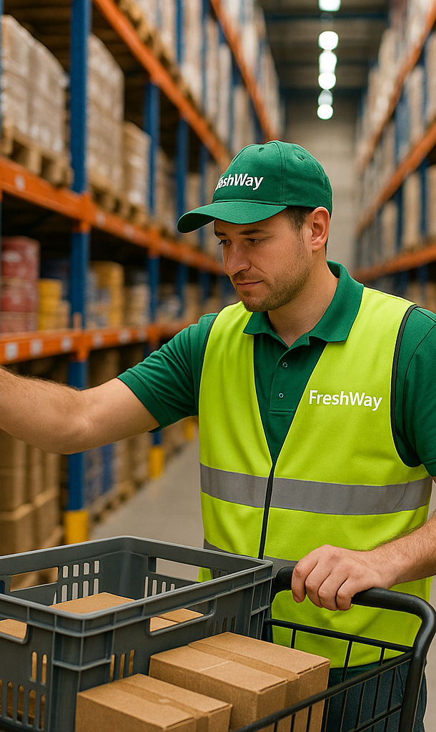
Presentation time
Present your digital developments

Slide 8
Feedback
Smart Logistics

Slide 9
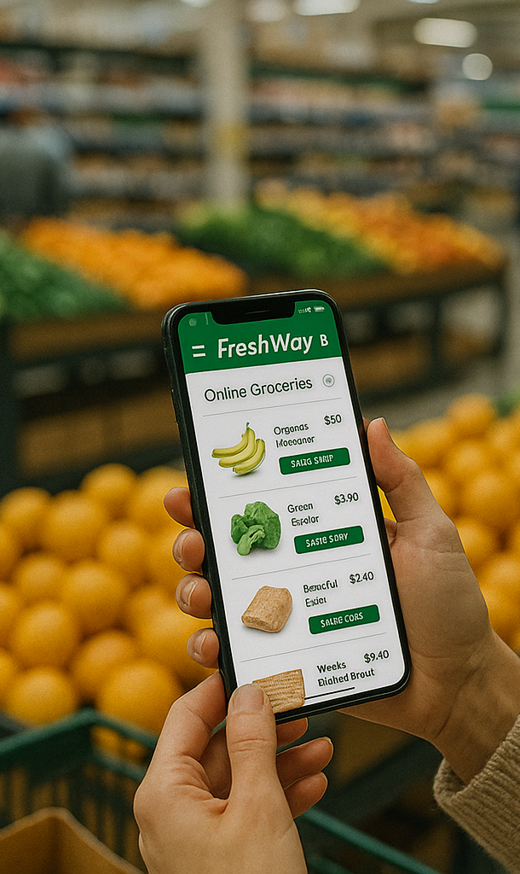
Recap until now
Logistics is getting smarter using technology and data
To leverage these possibilities we need a sturdy IT architecture, systems and software
Based on this backbone we can add new digital solutions
Cloud based solutions, interoperability and federated learning are key developments

Slide 10
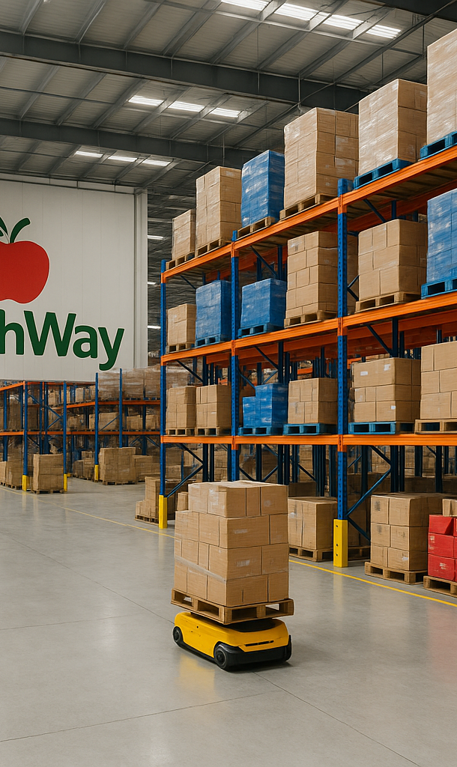
Program of today
Smart Logistics
Developments in (gen)AI
Impact on logistics

Slide 11
Developments in (gen)AI

Slide 12
Current developments in AI
Smart logistics
Agentic AI — handled separately in this lesson.
  It is no longer one of seven equal “developments”: it now has both a production track record and a documented failure rate.
Multimodal models
LLM’s vs SLM’s
On-device AI
Generative digital twins
Explainable & trustworthy AI
AI for sustainability
These six were not re-checked in the 2026 update — treat their maturity as unverified.
Notes:
Change: agentic AI gets its own treatment; the other six are unchanged.
Source: Onno, research block A2 (August 2026). Part 6.
Honest limitation, deliberately on the slide: Onno's brief was agentic AI only. The other six concepts were not re-examined, so no claim is made about their maturity. That is also a decent teaching moment about scope.

Slide 13
Flip the classroom (15 min.)
  Inbound
  Storage
  Orderpicking
  Outbound
  Supply chain management
  E-commerce
  Delivery to customer
Each group will research a concept
Answer the following questions:
  What is it? (1 sentence)
  How does it work?
  What benefit is there for logistics?
  Give an example for use within Freshway
  (choose which department you think is best suitable)
Agentic AI
Multimodal models
LLM’s vs SLM’s
On-device AI
Generative digital twins
Explainable & trustworthy AI
AI for sustainability

Slide 14
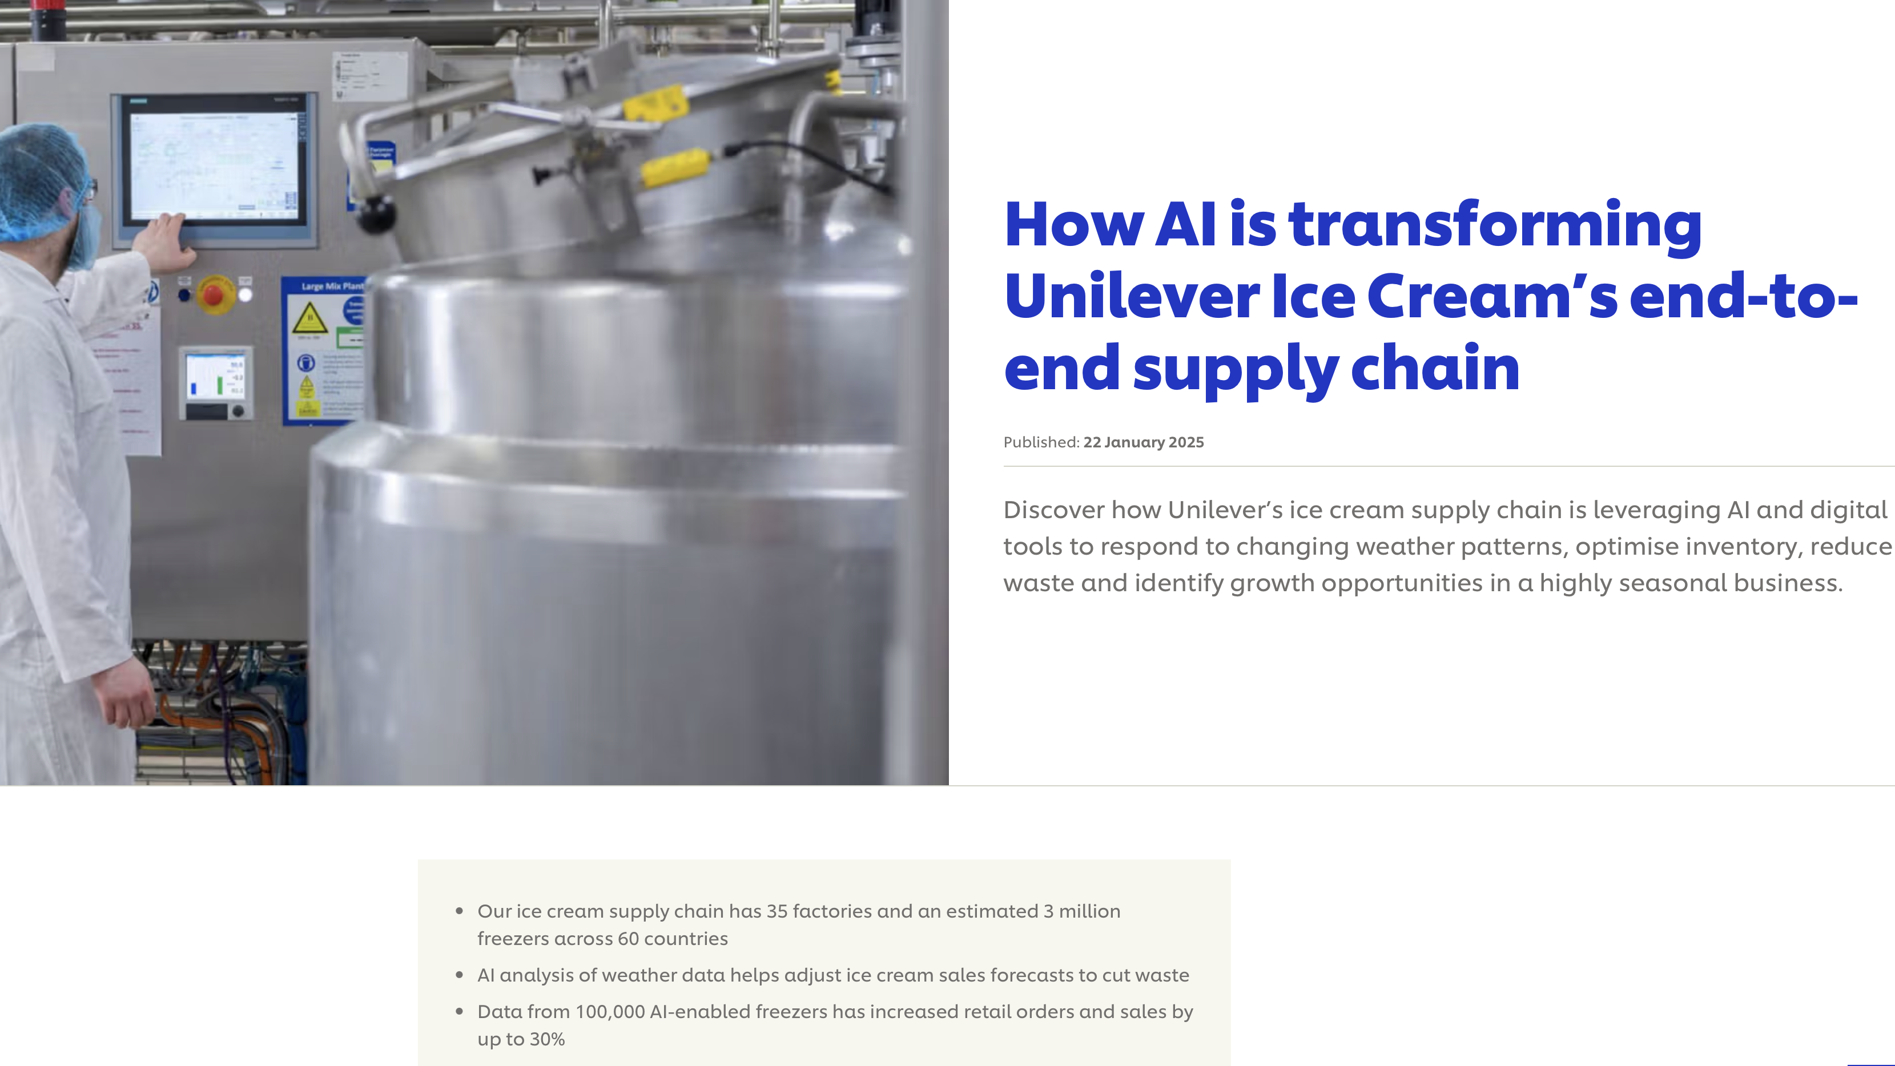

Slide 15
Impact on logistics

Slide 16
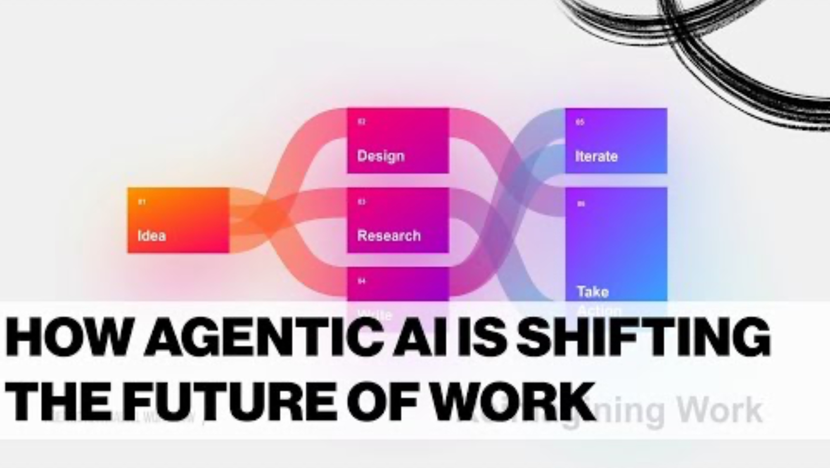

Slide 17
What is actually running: C.H. Robinson
Evidence tier 1
A US freight forwarder, and currently the best-documented case of agentic AI in production in logistics.
Quotes delivered in 32 seconds where a person took up to twenty minutes — and the agent does 100% of them, day and night. Over a million so far.
The order agent processes 5,500 truckload orders per day and saves about 600 person-hours per day.
Appointment confirmation automated across 42,000 locations; missed LTL pickups down 42%.
Why tier 1: the figures are in quarterly investor reporting — with legal liability attached — and were examined independently by Fortune and Forbes. Company figures, not an independent measurement.
Notes:
CORRECTION to the change proposal: slides 14 and 17 of the original deck are NOT empty. Slide 14 is a full-bleed screenshot of a Unilever article, slide 17 an embedded video on agentic AI. Both are kept unchanged; these six slides are an ADDITION after them, not a replacement.
Source: Onno, research block A2 (August 2026). Part 2.1. Recheck: mid-2027.
The transferable pattern for FreshWay: repetitive, high-volume, structured administrative work with a clear outcome. That is where agents demonstrably pay off — not in redesigning the chain. Relevant to Inbound, Outbound and E-commerce.

Slide 18
DHL — the win is integration, not the robot
Evidence tier 2
17 March 2026: the SVT Robotics SOFTBOT platform live at 30 sites worldwide, expanding to more than 100 within three years.
The point is orchestration: robot integrations are reported to go twelve times faster than custom links, which took six to eight weeks per technology.
DHL reports over 8,000 collaborative robots in its operation.
Since November 2025: HappyRobot agents handling phone and email for appointment scheduling, driver follow-up and warehouse escalations.
Note where the gain sits. Not in the AI, but in removing custom integrations — exactly the spaghetti IT landscape from Lesson 3.
Notes:
CORRECTION to the change proposal: slides 14 and 17 of the original deck are NOT empty. Slide 14 is a full-bleed screenshot of a Unilever article, slide 17 an embedded video on agentic AI. Both are kept unchanged; these six slides are an ADDITION after them, not a replacement.
Source: Onno, research block A2 (August 2026). Part 2.2. Independently reported by Modern Materials Handling, AJOT and Container News. Recheck: mid-2027.
This corrects a student intuition: they look for the innovation in the device. Here it is in the architecture.

Slide 19
Walmart — autonomy inside set limits
Evidence tier 2-3
Agents give an integrated stock picture across stores and fulfilment centres, flag and correct disruptions, and adjust order quantities using weather, live sales and stock positions.
Including price adjustments — but only within margin limits approved in advance by a human.
That is what “human oversight” looks like in practice: the agent acts on its own, inside a band someone set.
And it is what the EU AI Act will require of high-risk systems from December 2027.
Tier 2-3: reported by Supply Chain Dive and CIO, not traced back to primary Walmart documentation.
Notes:
CORRECTION to the change proposal: slides 14 and 17 of the original deck are NOT empty. Slide 14 is a full-bleed screenshot of a Unilever article, slide 17 an embedded video on agentic AI. Both are kept unchanged; these six slides are an ADDITION after them, not a replacement.
Source: Onno, research block A2 (August 2026). Part 2.3. Recheck: mid-2027.
The pre-approved margin band is the most useful detail in this block for the assignment: it is a concrete, designable form of human oversight that students can put in their own proposal.

Slide 20
Klarna — the KPIs stayed green
What went wrong, and why
In 2024 Klarna largely replaced customer service with AI: 2.3 million conversations in the first month, equal to about 700 staff, a reported saving of around $40m a year.
In May 2025 the CEO said publicly the company had gone too far, and it started hiring people again. A hybrid model now runs: AI for routine, people for escalations.
The mechanism is the lesson. Volume metrics stayed green the whole time — conversations handled, handling time, cost per conversation. The damage only showed in satisfaction and NPS, measured after the conversation.
Ask both questions: which KPI improves — and which KPI would deteriorate first if this fails, and are you measuring it?
Notes:
CORRECTION to the change proposal: slides 14 and 17 of the original deck are NOT empty. Slide 14 is a full-bleed screenshot of a Unilever article, slide 17 an embedded video on agentic AI. Both are kept unchanged; these six slides are an ADDITION after them, not a replacement.
Source: Onno, research block A2 (August 2026). Part 3.1. Recheck: mid-2027.
This connects straight to the sub-assignments of Lessons 3 and 4, which ask which KPIs are affected. Klarna shows that the question is incomplete without the counter-question.

Slide 21
The numbers behind the failures
Gartner, 2026
Gartner expects more than 40% of agentic-AI projects to be cancelled before the end of 2027 — rising costs, unclear business value, inadequate risk control.
And: organisations will abandon 60% of AI projects that are not supported by AI-ready data, through 2026.
Put that next to the slide you already have in Lesson 4: only 42% of Dutch companies have their internal data largely in order.
Two independent sources, two continents, one diagnosis: the problem is not the model, it is the foundation underneath.
Projects do not fail on the models. They fail on integration, data access, governance, accountability — and the jump from pilot to scale.
Notes:
CORRECTION to the change proposal: slides 14 and 17 of the original deck are NOT empty. Slide 14 is a full-bleed screenshot of a Unilever article, slide 17 an embedded video on agentic AI. Both are kept unchanged; these six slides are an ADDITION after them, not a replacement.
Source: Onno, research block A2 (August 2026). Part 3.3. Recheck: mid-2027.
Gartner also warns about 'agent washing' in supply-chain planning software (May 2026). Together with evofenedex's warning about 'AI-washing' (Lesson 4) that is a pattern from two independent sources.

Slide 22
Two claims about AI in shipping
One of them is verifiable
Claim A: “AI agents route 35% of Maersk's global container fleet and save $200 million a year in fuel.” Found on several vendor blogs. No Maersk source. No independent reporting. Untraceable.
Claim B: Maersk operates Star Connect, an AI platform for fleet energy efficiency processing over 2.5 billion IoT data points, and upgraded IoT connectivity for its reefer containers (Maersk, 2 July 2026). Published by the company, dated, checkable.
Claim A is more specific, more impressive and more quotable. That is exactly why you should distrust it.
Precision is not evidence.
Notes:
CORRECTION to the change proposal: slides 14 and 17 of the original deck are NOT empty. Slide 14 is a full-bleed screenshot of a Unilever article, slide 17 an embedded video on agentic AI. Both are kept unchanged; these six slides are an ADDITION after them, not a replacement.
Source: Onno, research block A2 (August 2026). Part 4.2. Recheck: mid-2027.
Onno found this live while researching and could not substantiate claim A. Present it as a demonstration of how a claim spreads, not as an accusation against Maersk, which has nothing to do with it.

Slide 23
Announced, or actually running?
Announced or running · Amazon
October 2025 · announced
Blue Jay: a multi-arm robot, built with digital twins in just over a year.
Project Eluna: an AI agent that predicts bottlenecks and recommends actions. Pilot at one site.
February 2026 · Amazon's own page
“Amazon is no longer utilizing Blue Jay in operations.”
Eluna: no published results.
Ask of every case: who measured this, and what do they gain from the number?
Source: About Amazon, United States, 2025, updated 2026
Notes:
Amazon · aangekondigd tegenover wat echt draait · nieuw 16-10-2026
Oktober 2025 kondigde Amazon twee dingen tegelijk aan: Blue Jay, een robot met meerdere armen, in iets meer dan een jaar ontwikkeld met digital twins, en Project Eluna, een agentic AI-systeem dat knelpunten in een fulfilmentcentrum voorspelt en operators acties aanbeveelt (pilot voor sortering in één vestiging in Tennessee). Op de eigen pagina staat sinds 25 februari 2026: 'Amazon is no longer utilizing Blue Jay in operations.' Van Eluna zijn geen resultaten gepubliceerd. Een reden voor het stoppen van Blue Jay is niet gegeven.
Lesmoment: een aankondiging is geen resultaat. Past naast de Maersk-dia ervoor (twee claims, één na te gaan) en vooruit naar Five questions, vraag 3 (wat gebeurt er op schaal?).
Bron: About Amazon, 'New robots and agentic AI', oktober 2025, update 25 februari 2026. https://www.aboutamazon.com/news/operations/new-robots-amazon-fulfillment-agentic-ai (onderzoek Onno, 16-10-2026).

Slide 24
GenAI at work: paperwork first
New cases · 2026
Kuehne+Nagel
project44
PostNL
Running, scaling up
Early deployments
A plan, not yet measured
Assistant Claire summarises customs documents and prepares the declaration. Staff handle the exceptions. Agents for order intake are being rolled out.
An agent compares freight rates, runs small tenders and negotiates renewals, within limits the customer sets. Reports 4.1% lower freight spend (own figure).
Calls itself AI-first. AI agents are one route to €170–180m savings in 2027–28. And customers now arrive through other companies' AI assistants.
Source: Kuehne+Nagel, Switzerland, 2026
Source: AJOT, United States, 2026
Source: Pulse 2.0, United States, 2026
Notes:
Drie casussen uit 2026 · nieuw 16-10-2026
Gekozen uit tien voorbeelden van Onno (november 2025 tot augustus 2026), omdat ze laten zien wat in de andere dia's ontbrak: GenAI op papierwerk en gesprekken, en een Nederlands voorbeeld. Alle effectcijfers komen van de bedrijven zelf; een onafhankelijke meting is niet gevonden. Daarom staat bij elk voorbeeld of het draait of alleen gepland is.
Kuehne+Nagel: assistent Claire vat douanedocumenten samen en bereidt aangiften voor. Agents voor orderintake, klantcommunicatie, documenten en uitzonderingen worden wereldwijd uitgerold. De CEO noemt dit het begin van de opschaalfase; volledig zelfstandige agents zijn een toekomstdoel. Bron: Kuehne+Nagel, Annual Report 2025, interview met de CEO (2026).
project44: een inkoopagent vergelijkt contracttarieven met de markt, houdt kleine tenders en onderhandelt verlengingen. De klant zet de grenzen (tarieven, vervoerders), kan beginnen met alleen aanbevelen; nieuwe vervoerders en spotdeals gaan naar een mens. project44 meldt 4,1% lagere vrachtkosten bij vroege klanten. Bron: AJOT, 26-02-2026. Past bij Walmart: autonomie binnen grenzen.
PostNL: noemt zich AI-first (klantenservice, app, sorteren, routeplanning). Bij de halfjaarcijfers van augustus 2026 is het besparingsplan voor 2027-2028 verhoogd naar 170 tot 180 miljoen euro, met AI-agents als één van de oorzaken. Doel, geen gemeten effect; de augustuscijfers alleen in secundaire bron. Ook: klanten komen steeds vaker binnen via externe AI-assistenten. Dat raakt de Communication Council. Bron: Pulse 2.0, 03-08-2026; Emerce, 17-09-2025.
Trend (Onno): papierwerk en gesprek eerst, fysiek werk later. Voorbeelden met gerapporteerde resultaten zitten in communicatie, documenten, douane en inkoop.

Slide 25
Excercise

Slide 26
Vibecode a logistics app in 20 minutes
Exercise · vibecoding
You describe it in plain language. The AI writes the code. You test whether it is right.
0–3′
Pick one app idea and open ChatGPT, Gemini or Claude
3–12′
Paste the start prompt, then two rounds of improvement
12–15′
Test your app with the test case. Is the answer right?
15–20′
Show it, and reflect: what did the AI do well, what did you check?
Invented numbers only: no names, no company data, no FreshWay files.
Notes:
Vibecode-opdracht · 20 minuten · nieuw 16-10-2026
Vibecoden: je beschrijft in gewone taal wat je wilt, de AI schrijft de code, jij test of het klopt. Doel van deze oefening is niet programmeren leren, maar zien wat GenAI nu kan en ervaren waar je het moet controleren. Dat sluit aan op de vraag uit de masterclass: wat is een antwoord, en wat is een bruikbaar antwoord?
Alleen of per twee, op de eigen laptop. Tool naar keuze: ChatGPT of Claude, allebei met een gratis account. De prompts staan op de lespagina, zodat studenten ze kunnen kopiëren; niet overtypen van het scherm.
Tijd: 0-3 kiezen en tool openen · 3-12 startprompt en twee verbeterrondes · 12-15 testen met de testcase · 15-20 drie studenten laten zien, iedereen reflecteert met de buur. Houd de tijd strak: om minuut 12 moet iedereen testen, ook als de app nog niet mooi is.
Regel uit de studiewijzer: geen gegevens die herleidbaar zijn tot personen, bedrijven of instellingen. Dus verzonnen getallen, geen FreshWay-bestanden, geen namen.
De opdracht vervangt de transportplanning-oefening (met de hand in Excel, daarna met een AI-assistent). Die liet hetzelfde verschil zien; een routekostenvergelijker staat als app-idee in de keuzelijst.

Slide 27
Pick one app
Exercise · vibecoding
1 EOQ calculator
How much to order at once, so ordering and holding costs are lowest
2 Safety stock & reorder point
When to reorder, and how big the buffer must be
3 Route cost comparer
Diesel or electric truck: energy cost of one trip
4 Dock planner
Trucks, docks and unloading times on a timeline: who waits?
5 Pick-route visualiser
Pick locations on a warehouse grid: draw the route and its length
6 CO₂ per shipment
Tonne-kilometres times an emission factor, per transport mode
Notes:
Keuzelijst · 0-3 min
Zes ideeën, elk klein genoeg voor tien minuten bouwen en elk met een testcase met een bekend antwoord (dia Test before you trust). Daardoor kan iedereen controleren, ook wie geen code leest.
Vakinhoud die erin zit: EOQ en veiligheidsvoorraad (voorraadbeheer), routekosten diesel tegen elektrisch (transport, raakt les 4), dockplanning (inbound), looproute bij orderpicken (warehousing), CO2 per zending (duurzaamheid). Studenten kiezen bij voorkeur het idee dat bij hun eigen afdeling past.
Wie snel klaar is: een tweede idee, of de app uitbreiden met een tweede scenario naast het eerste.

Slide 28
Your start prompt
Exercise · vibecoding · copy it from Brightspace
Build an interactive app as one self-contained HTML file (HTML, CSS and JavaScript in one file, no external libraries, no login, no saved data). The app is a [your idea] for a logistics planner. The user enters the numbers in input fields; fill them with invented example values. Show the result in large type, with the formula and the filled-in numbers underneath. Keep it simple and readable.
ChatGPT
code appears in the chat: switch to Preview
Claude
free account: the app opens on the right as an artifact
No preview? Copy the code, save it as app.html, open it in your browser.
Notes:
Startprompt · 3-6 min
De prompt staat op de lespagina om te kopiëren. Studenten vullen alleen het idee in. 'Eén HTML-bestand, geen externe bibliotheken' is bewust: zo werkt de app in beide tools en ook als losse file in de browser.
Toolstand, gecontroleerd 16-10-2026:
- ChatGPT: Canvas bestaat niet meer in GPT-5.5, het standaardmodel, ook voor gratis accounts (release notes OpenAI, 28-05-2026). Code verschijnt nu als codeblok in de chat; een HTML-blok heeft een schakelaar Code/Preview. Welke knoppen er staan, verschilt per abonnement en uitrol.
- Claude: artifacts zitten in het gratis plan. Voorwaarde: Settings > Capabilities > code execution and file creation staat aan.
- Altijd werkt: code kopiëren, opslaan als app.html (Kladblok of TextEdit als platte tekst) en openen in de browser.
- Gemini Canvas zou ook kunnen, maar is niet gecontroleerd.

Slide 29
Make it better: two rounds
Exercise · vibecoding · copy them from Brightspace
A
Round 1, choose A or B
Add input checks: block empty, zero or negative values and say what is wrong.
B
Round 1, choose A or B
Add one chart that helps a planner decide, for example cost per order size, a timeline per dock or the route on a grid. Label the axes.
C
Round 2, everyone
Explain step by step how the app calculates the result, list every assumption it makes, and tell me which one I should check.
Error or blank screen? Paste what you see and ask for a fix.
Notes:
Verbeteren · 6-12 min
Twee rondes. Ronde 1 kiest de student zelf: A (invoercontrole) of B (een grafiek). Ronde 2 is voor iedereen C: laat de AI uitleggen hoe hij rekent en welke aannames hij doet. C is geen versiering maar de voorbereiding op het testen; daar zie je bijvoorbeeld welke z-waarde of welke emissiefactor de AI zelf heeft gekozen.
Valt de app om of geeft hij een fout: plak de foutmelding of beschrijf wat je ziet ('the button does nothing') en vraag om een herstel. Dat telt niet als ronde.

Slide 30
Test before you trust
Exercise · vibecoding · enter these numbers
1 EOQ
demand 12,000/yr · order cost €50 · holding €2/unit/yr
≈ 775 units
2 Safety stock
100/day · st.dev. 20 · lead time 4 days · z = 1.65
SS ≈ 66 · ROP ≈ 466
3 Route cost
250 km · diesel 30 l/100 km at €1.70 · electric 120 kWh/100 km at €0.30
€127.50 vs €90.00
4 Dock planner
6 trucks arrive 06:00 · 2 docks · 45 min each
last done 08:15
5 Pick route
depot (0,0) · picks (0,4), (3,4), (3,0) · walk along aisles
14 m
6 CO₂
20 t · 300 km · 0.1 kg CO₂ per tonne-km
600 kg
Notes:
Testen · 12-15 min
Elke testcase heeft een antwoord dat je met de hand of in Excel kunt narekenen. Uitwerkingen:
1 EOQ = wortel(2 x 12.000 x 50 / 2) = wortel(600.000) = 774,6, dus ongeveer 775.
2 Veiligheidsvoorraad = 1,65 x 20 x wortel(4) = 66; bestelpunt = 100 x 4 + 66 = 466. Rekent de app met 1,645, dan 65,8 en 465,8. Rekent hij ook met spreiding in de levertijd, dan wijkt het af: vraag waarom.
3 Diesel: 250 km x 30 l/100 km = 75 l x 1,70 = 127,50. Elektrisch: 250 x 120 kWh/100 km = 300 kWh x 0,30 = 90,00. Verschil 37,50.
4 Zes trucks om 06:00, twee docks, 45 min: drie golven, laatste klaar om 08:15. Wie wacht het langst? Truck 5 en 6, 90 minuten.
5 Rechthoek van 3 bij 4 meter heen en terug: 4 + 3 + 4 + 3 = 14 m (loopafstand langs gangpaden, geen diagonaal). Diagonaal gerekend geeft een korter, fout antwoord.
6 20 t x 300 km = 6.000 tonkilometer x 0,1 kg = 600 kg CO2. De factor is verzonnen voor de test. Kiest de app zelf een factor: waar komt die vandaan? Kan de AI een bron noemen die je kunt nalezen?
Klopt het niet, dan is dat geen mislukking maar de les van vandaag: de app zag er goed uit en rekende fout. Laat de student dat bij het laten zien vertellen.

Slide 31
Show it, then reflect
Exercise · vibecoding
Show · 3 volunteers, 1 minute each
What does your app do?
Was the test case right?
What did you have to get fixed?
Reflect · with your neighbour
What did the AI do well?
What did you have to check, and how?
Is your app an agent, or automation?
Which Human-AI label fits what you just did? Offloader, Self-Checker, Critical Verifier or Co-Creator. Compare it with the label on our GenAI transparency slide.
Notes:
Laten zien en reflectie · 15-20 min
Laten zien (3 min): drie studenten op het grote scherm, elk een minuut. Drie dingen: wat doet de app, klopte de testcase, en wat moest je laten herstellen. Kies bij voorkeur één app die fout rekende; die leert de zaal het meest.
Reflectie (2 min, met de buur): de twee vragen links, dan het label. De Human-AI Agency-labels van Boetje en Baake (2026) staan al in deze les, op de slotdia GenAI transparency: wij noemen daar Creative Director voor dit deck. Wie de app overnam zonder te testen was Offloader; wie testte aan eigen kennis Self-Checker; wie narekende in Excel of een bron zocht voor een factor Critical Verifier; wie stap voor stap bijstuurde Co-Creator. Er is geen goed label, wel een bewust gekozen label.
Brug naar de masterclass: is deze app een agent? Nee. Het is gewone automatisering die de AI voor je schreef. Dezelfde toets als bij Five questions, vraag 1.
Voor het portfolio: wie GenAI gebruikt, vermeldt dat volgens de studiewijzer ('During the preparation of this work, I used ...'). Het label mag erbij; verplicht is het niet.

Slide 32
Five questions before you use an agent (1/2)
Advice, not a brochure
1. Is it an agent, or automation with a new label?
  Gartner's test: does the system independently re-sequence objectives, negotiate trade-offs and adapt its execution logic? If not, it is conventional automation — often the right answer, but price it as such. Relabelling it is called agent washing.
2. Is the data ready?
  Gartner expects 60% of AI projects without AI-ready data to be abandoned. In Dutch trade and logistics only 42% have their internal data largely in order. Show which data your agent consumes and whether FreshWay actually has it, at the quality and frequency needed.
3. What happens at scale?
  Pilots succeed and roll-outs fail. What works for 50 users can collapse at 5,000. Which part of your design changes when volume multiplies?
Notes:
Source: Onno, research block A2 (August 2026). Part 5. Recheck: mid-2027.
This is the slide that sits closest to rubric criterion 3 (requirements, costs, benefits, risks). Use it as a checklist when you read the sub-assignments.

Slide 33
Five questions before you use an agent (2/2)
Advice, not a brochure
4. Which KPI would reveal that it is failing?
  Klarna's volume metrics stayed green while service quality fell. Name both the KPI you expect to improve and the KPI that would deteriorate first — and make sure you are measuring it.
5. Does it have to disclose itself?
  Since 2 August 2026 the EU AI Act requires that people are told when they interact with an AI system, and an agent must disclose both that it is AI and on whose behalf it acts. If your agent calls a carrier, emails a supplier or chats with a consumer, this applies to you now — not in 2027.
Sources: Gartner (May-June 2026); evofenedex (2025); Forbes (May 2025); EU AI Act Article 50.
Notes:
Source: Onno, research block A2 (August 2026). Part 5. Recheck: mid-2027.
This is the slide that sits closest to rubric criterion 3 (requirements, costs, benefits, risks). Use it as a checklist when you read the sub-assignments.

Slide 34
EU AI Act — what applies to your agent
In force and coming up
Applies now: prohibited practices (Feb 2025); obligations for general-purpose AI providers (Aug 2025); Article 50 transparency (2 Aug 2026).
Article 50 in one line: an AI agent must disclose that it is AI and on whose behalf it acts. A customer-facing chatbot must already say so.
Postponed, not cancelled: stand-alone high-risk systems (Annex III) from 2 Dec 2027; AI embedded in regulated products (Annex I) from 2 Aug 2028.
Annex III point 4 covers employment and worker management — including task allocation and monitoring and evaluating performance and behaviour.
If your solution assigns picking tasks by measured productivity, or scores driver behaviour, it is likely high-risk. Which parts of your design fall under Annex III, and what does compliance cost?
Notes:
New slide, no predecessor. Source: Onno, research block A3 §3.3 (Regulation (EU) 2026/1744, the Digital Omnibus). Recheck: February 2027.
This hits Order picking, Storage and Outbound transport directly — it is not an edge case in this course.

Slide 35

Next sub-assignment
Portfolio
Adding on to your digital developments (week 4), what AI technology can make these even smarter?
Describe multiple use cases how and where this technology is used
Describe what is needed in terms of hardware, software and data to make this work
Which KPI’s are affected?

Slide 36
Impact on FreshWay - Architecture Board Meeting
Work with your group
  What is the impact of all the developments mentioned on FreshWay specifically on your department?
  Which alignments do you foresee with other departments?
  Like last week: every team assigns one representative to join the ABM.
  The other team members can function as back-up or already start with the question: what does this mean for your department in terms of:
    Technology
    Data
    Planning
    Forecasting
    Employees
    Customers

Slide 37
Next sub-assignment
Portfolio
Hand in your document next Monday at the latest
In the next lesson we give general feedback in class
This will give you an indication if you are on the right track
Prepare a presentation of max 3 slides for the next lesson
One group will be randomly selected to present next lesson
(if you don’t have to present you can use the presentation for the end assessment)

Slide 38
AI Impact Notes: whose data does your AI need?
The five bodies · 35 minutes, all at the same time
In the Data Council
In the MT
1
Each department brings one AI idea and its data
Delivered · needed · blocked
Draft the seven commitments
Finished? Listen in at a council
2
Per idea: who supplies it, which fields, how often
3
Supplier confirms; new flow, new agreement
Technology Council
Investment Council
Communication Council
AI in the register: agent, or automation?
Per AI idea: cost, benefit, and the KPI that falls first
Where an agent talks to people, it says it is AI
A council that writes nothing down has not met.
Notes:
10:05 · 35 min · alle vijf de organen tegelijk
Data Council (de hoofdrol deze les): de cross-delivery van les 5 is de AI Impact Note, een AI-toepassing die alleen werkt als een andere afdeling data levert. De Data & Interface Officers brengen per afdeling één AI-idee mee en de data die het nodig heeft. Per idee: welke afdeling levert, welke velden, hoe vaak. De leverende afdeling bevestigt dat ze het kan leveren. Gaat er een nieuwe stroom over een afdelingsgrens, dan komt er een Interface Agreement onder (sjabloon 7); de ontvangende afdeling bevestigt. Bron: lesconcept §2 (les 5), het stappenmodel (les 5: data van een ander, via een Interface Agreement) en de councilskaart van september.
MT: hetzelfde als elke les. Ronde geleverd · nodig · geblokkeerd, en de zeven toezeggingen in concept in de MT-notulen (who · commits to deliver · to whom · by when). Klaar? De manager luistert mee bij een council naar keuze en neemt niet over.
Technology Council: zet de AI-toepassingen in het Technology Register, met de vraag uit de masterclass: agent of automatisering? Dat is het vervolg op Frits' Architecture Board Meeting (dia Impact on FreshWay): wat betekenen de AI-ontwikkelingen voor de afdelingen, en past het in de ene architectuur van FreshWay.
[AFGELEID UIT DIT DECK, niet door Frits vastgesteld] Investment Council: per AI-idee kosten en baat in het Investment Register, plus de KPI die als eerste zou verslechteren (Klarna, Five questions vraag 4). Communication Council: waar praat een agent met mensen (klant, chauffeur, leverancier)? Daar moet hij zeggen dat hij AI is en namens wie hij handelt (AI Act artikel 50, dia EU AI Act). Pas aan of vervang.

Slide 39
Department work: your AI Impact Note
Back at your own table · 30 minutes
1
Debrief: what did your council settle?
2
Per AI idea: agent, automation, or a pivot table?
3
Divide SA4: who researches what, by when
4
Your commitment, and who supplies your data
Your manager takes this to the Board close.
Notes:
10:40 · 30 min · docenten lopen rond
Het enige moment waarop de hele afdeling samen werkt. Vier taken, in deze volgorde. Eerst de debrief: iedereen vertelt in één minuut wat zijn council heeft vastgelegd, de Data & Interface Officer als eerste, want die komt terug met wie de data voor jullie AI-idee levert. Dan per AI-idee de test uit de masterclass: is het een agent of automatisering, en had een draaitabel het ook opgelost? Dan SA4 verdelen. Als laatste de toezegging, inclusief welke afdeling de data levert en de AI Impact Note bevestigt.
Vragen bij het rondlopen, uit de lespagina: welke KPI verbetert, en welke KPI verslechtert als eerste als het misgaat? Meet FreshWay die tweede al? Een voorspelling zonder foutmarge is een half getal (kolom forecast_error_pct).
Drie afdelingen hebben nu hun mandaatfile v1. De andere vier toetsen hun AI-idee eraan: Compliance File, Energy & Capacity File, Customer Promise.

Slide 40
Seven commitments, out loud
Board close · 5 minutes
“[Department] hands in SA4 by Monday, end of day,
with an AI Impact Note, confirmed by [dept].”
Recorded in the MT minutes · the Board logs one line
Lesson 6 opens with the check on it, and with your Board Memo
Lesson 6: the Interim Board Review, with both CEOs
Managers: hand in your Board Memo before you leave.
Notes:
11:10 · 5 min · beide docenten
Elke manager spreekt de toezegging uit in de vorm van de zin op de dia. De MT-notulen hebben er zeven rijen voor; de Board legt in de Board Decision Log één regel vast: de zeven toezeggingen voor les 6 zijn genoteerd.
Les 6 is anders: de Interim Board Review, plenair met beide CEO's, in plaats van de organen en een deel van het afdelingswerk (lesconcept §2). Kondig dat nu aan, zodat de managers weten dat hun afdeling daar zichtbaar wordt.
De managers leveren voor ze weggaan hun Board Memo in (één A4 per les). Alleen voor de docenten, niet hardop: een verzoek in de Board Memo van deze les is een van de twee schriftelijke aanleidingen voor de scopeverkleining in les 6 (lesconcept §5b). Niet aankondigen; een route die je aankondigt, wordt ingepland.
Herhaal de afspraak van dia 'Next sub-assignment': SA4 inleveren maandag einde dag; de feedback komt in les 6 algemeen in de les.

Slide 41
Next week
Portfolio
Feedback on your research
Presentation of one plan (be prepared!)
Lesson Self organising logistics

Slide 42
GenAI transparency
GenAI
These slides build on the 2025 course materials written by your lecturers. For 2026 the facts, figures and examples were checked and updated with GenAI support, and a number of slides were added.
Human-AI Agency Label: Creative Director — your lecturers set the structure and the line of reasoning; GenAI carried out specific parts within that frame, and every change was checked before it went in.
Labels source: Boetje, J., & Baake, G. (2026). Nine prototypical human-AI agency patterns [Figure]. figshare. https://doi.org/10.6084/m9.figshare.31706884 (CC BY 4.0).
Notes:
Afsluitende dia: de GenAI-verklaring bij dit deck. Kort benoemen dat wij als docenten zelf ook transparant zijn over GenAI-gebruik — hetzelfde als wat wij van jullie vragen bij het portfolio. Niet voorlezen; één zin volstaat.

